Slide 1
MPCA Mini Project
Automated Head Light
For Vehicles and Security System

Slide 2
Team Members:
Chandan Balaji BP
B R Naveen
Akshay JS
Akanksha Kamble

Slide 3
Idea:
#According to surveys , most of accidents occur at night time. These accidents are mainly because of driver inattentiveness while driving.
#Thus an autonomous car will ensure a safe and easy driving without much human intervention. The effect at night time due to high intensity beam too is responsible for fatal accidents.
#An automatic beam switcher helps to switch the high beam to low beam even when driver is inattentive, thereby preventing accidents.
# The project aims at developing a device or a system to sense the intensity of headlight from opposing vehicle and switching the intensity of headlight automatically based on readings from sensor.

Slide 4
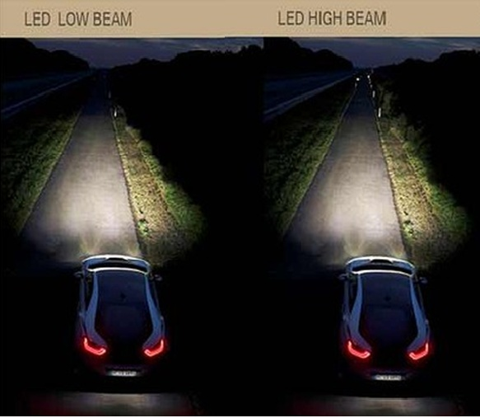
Difference between Low Beam and High Beam

Slide 5
Sensors Required:
BH 1750 DLI Sensor
RF Transmitter
RF Receiver
Other Components:
Arduino Uno Board
Connecting Wires
Power Supply
5V Relay
Bread Board
LED * 2

Slide 6
Working:
Initially the intensity values from the opposing vehicle are read by the digital light sensor. These readings are sent to the Arduino board. If the value exceeds the limit of around 100lux, indicating that the vehicle is nearing us, the device switches the beam of the headlight from high to low using a 5V relay. Simultaneously, the similar process takes place in the opposing vehicle as well. Once the vehicles have passed by each other the intensity again goes from low to high. Thus the system automates the headlights and assists the driver.

Slide 7
Working:
Two modes will be provided. One mode enables the LDR Sensor
And detects the light from the approaching vehicle and head light
(low beam/high beam) is also varied accordingly.
The Second Mode can be used for long Drives.
Emitter and Receivers have to be mounted in all the vehicles.
On pressing a button in one vehicle , waves are emitted
And received by the Receiver Circuit of the approaching vehicle and Low beam mode is activated.
Thus , the accidents rates can be reduced.
The further extension of the project can be merging LDR sensor/BH 1750 DLI Sensor and Emitter/Receiver for more accurate results.

Slide 8
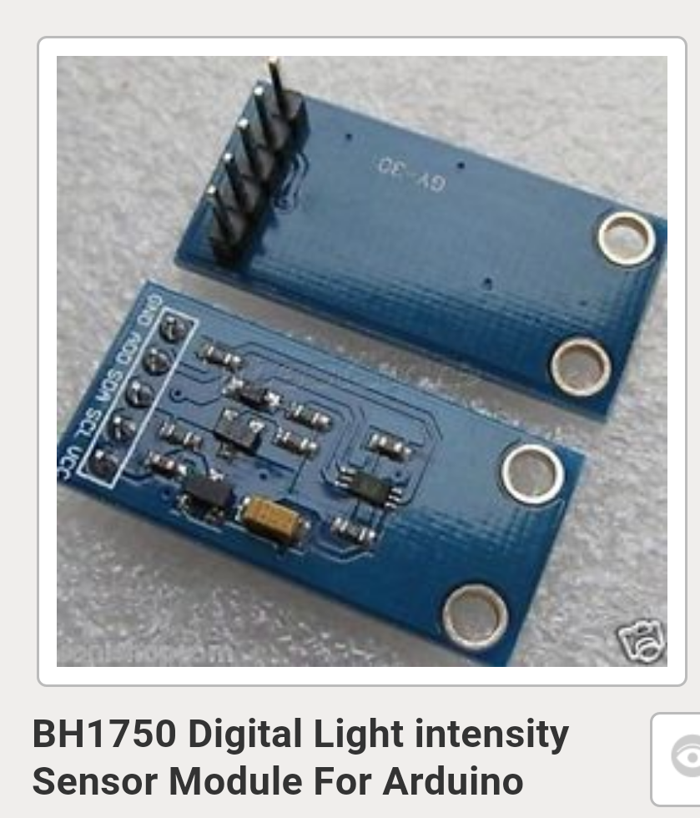
BH 1750 DLI Sensor

Slide 9
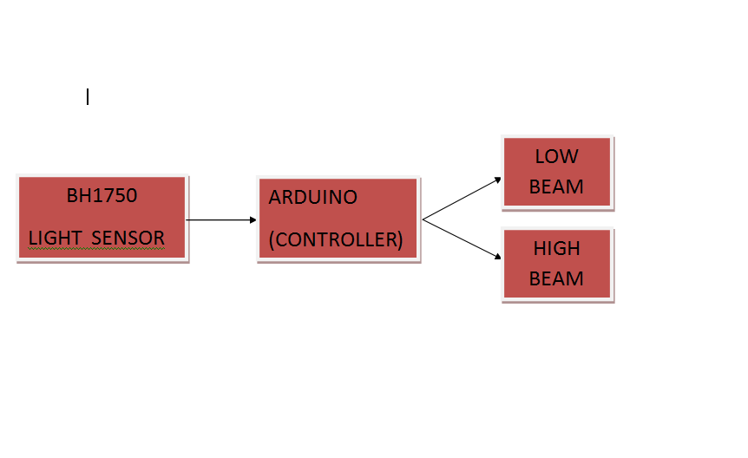
BLOCK DIAGRAM

Slide 10
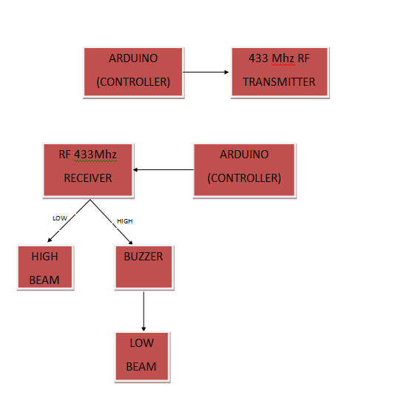
BLOCK DIAGRAM

Slide 11
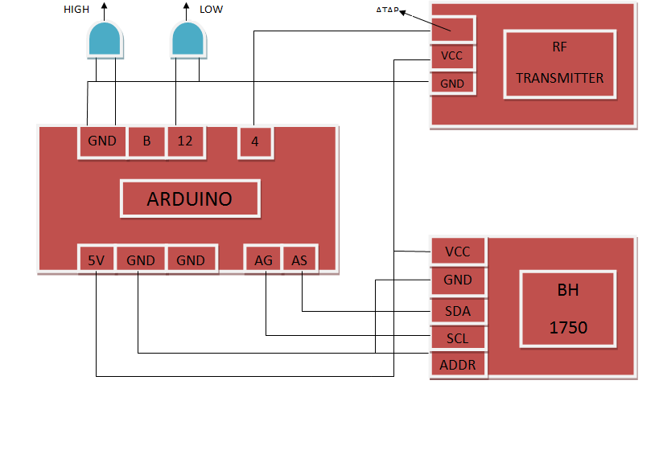
CIRCUIT DIAGRAM

Slide 12
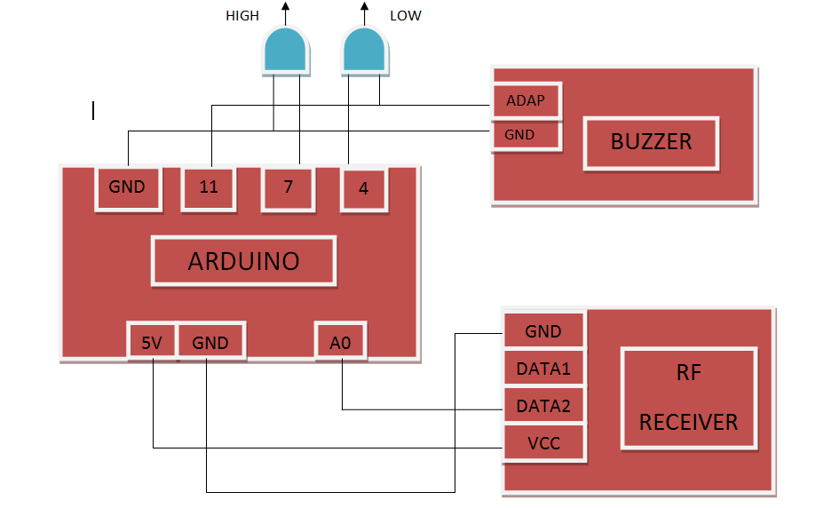
CIRCUIT DIAGRAM

Slide 13
Conclusion:
The working product thus achieves the aim of switching the beam from high to low or vice-versa. This system not only assists the driver but also protects him from the temporary blindness due to the opposing headlight glare. Thus, the product provides safety to the driver especially during the night time. The product is low cost and small in size..

Slide 14
THANK YOU
☺

